Slide 1

NSG Pilkington – University of Liverpool Machine Learning Project: 17/03/2021
Dr. Peter Green
Diego Echeverria
Sarini Jayasinghe
Risk Institute,
School of Engineering

Slide 2
List of activities
MKIV data conditioning analysis
Sensitivity study on effect of changed on error/prediction accuracy?
Use the continuous N = 11623 data for training and testing.
Relevant inputs grouped by their potential controllability
Online linear regression

Slide 3
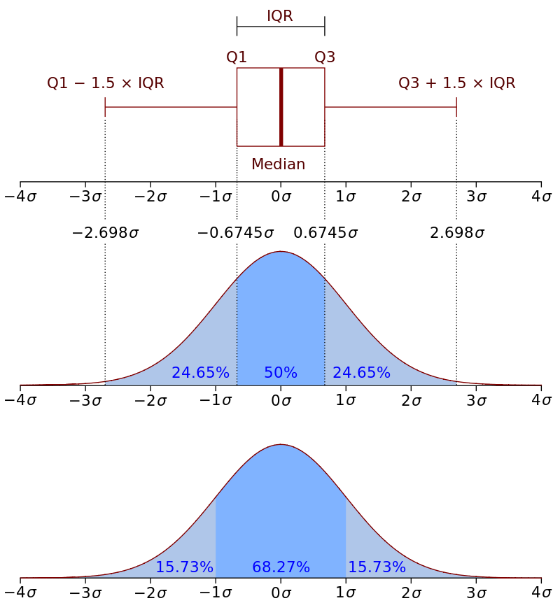
Fault Density Signal
Furnace fault Pipeline
Isolate to be between 25/07/20 and 03/01/21
Remove spikes
Low pass filter
High pass filter
Spike locations

Slide 4
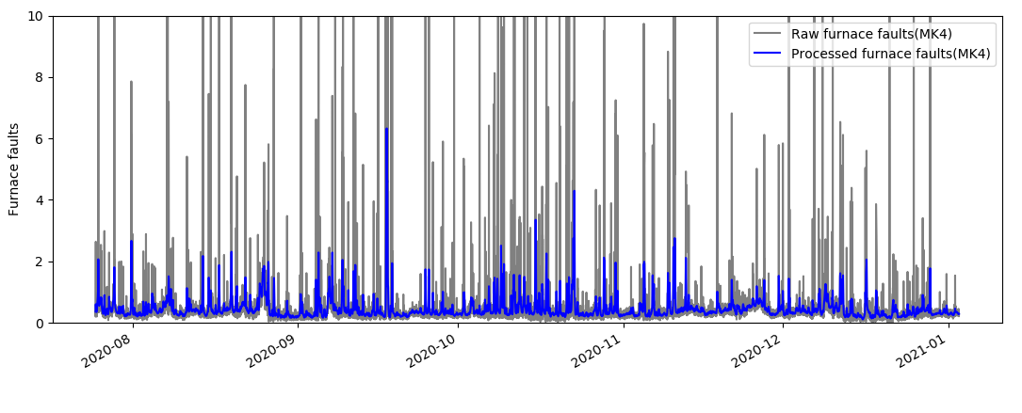
Dataset 2 (2020 to 2021, around N=11500)
MK4 data filtering (spike removal - 3 sigma from median)
Low pass filter, normalised cutoff-frequency W_{LC}= 0.1≈3hrs and
high pass filter normalised cutoff-frequency W_{HC} =0.01 ≈33hrs

Slide 5
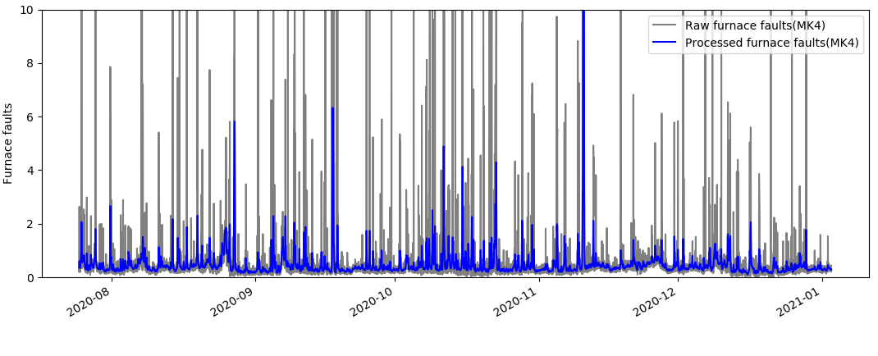
Dataset 2 (2020 to 2021, around N=11500)
Low pass filter, normalised cutoff-frequency W_{LC}= 0.1≈3hrs and
high pass filter normalised cutoff-frequency W_{HC} =0.05 ≈6hrs

Slide 6
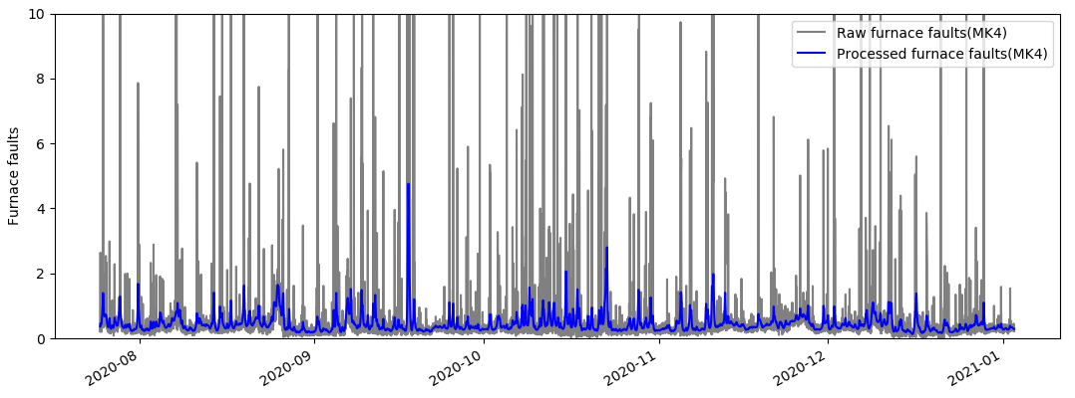
Dataset 2 (2020 to 2021, around N=11500)
Low pass filter, normalised cutoff-frequency W_{LC}= 0.05≈6hrs and
high pass filter normalised cutoff-frequency W_{HC} =0.01 ≈33hrs

Slide 7
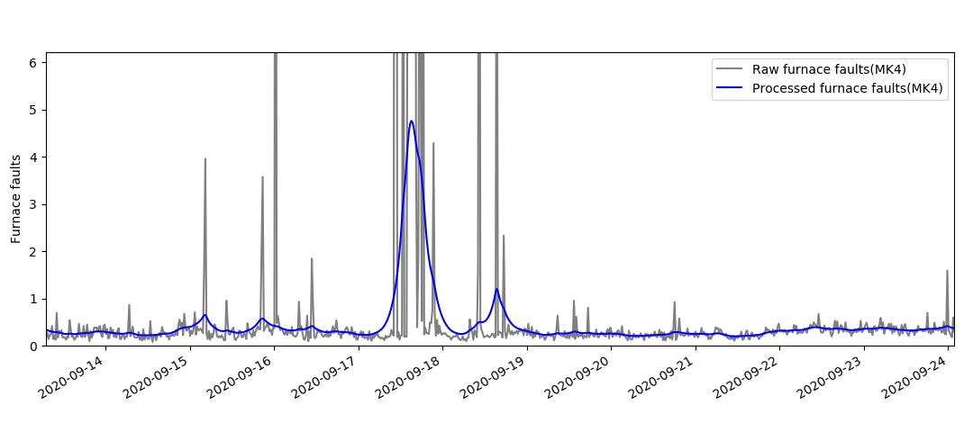
Dataset 2 (2020 to 2021, around N=11500)
Low pass filter, normalised cutoff-frequency W_{LC}= 0.05≈6hrs and
high pass filter normalised cutoff-frequency W_{HC} =0.01 ≈33hrs

Slide 8
Fault Density Signal
Furnace fault Pipeline
Isolate to be between 25/07/20 and 03/01/21
Remove spikes
Low pass filter
High pass filter
Spike locations

Slide 9
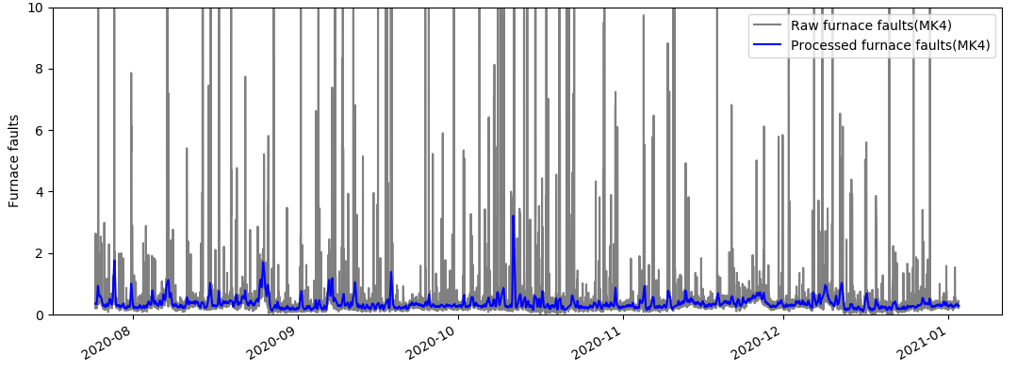
Dataset 2 (2020 to 2021, around N=11500)
MK4 data filtering (spike removal – Inter-quartile range)
Low pass filter, normalised cutoff-frequency W_{LC}= 0.1≈3hrs and
high pass filter normalised cutoff-frequency W_{HC} =0.01 ≈33hrs

Slide 10
List of activities
MKIV data conditioning analysis
Sensitivity study on effect of changed on error/prediction accuracy?
Use the continuous N = 11623 data for training and testing.
Relevant inputs grouped by their potential controllability
Online linear regression

Slide 11
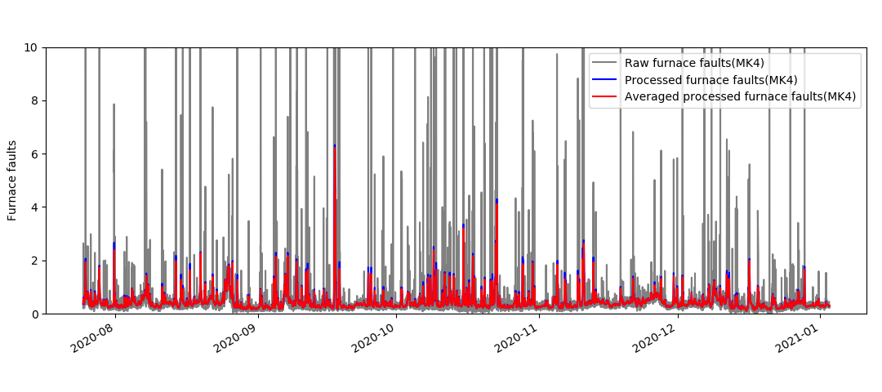
Dataset 2 (2020 to 2021, around N=11500)
Averaged after filtering MK4 data (sensitivity =1hr)

Slide 12
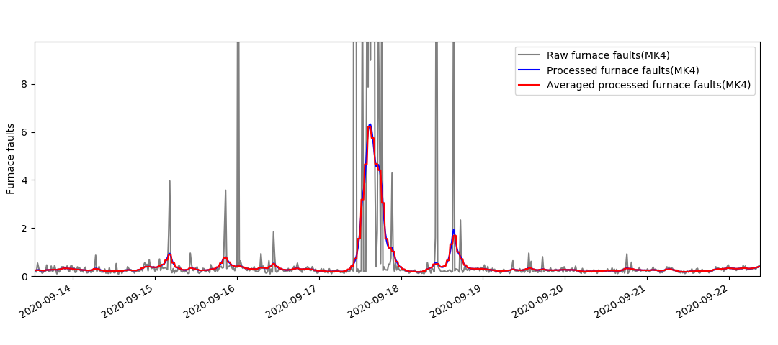
Dataset 2 (2020 to 2021, around N=11500)
Averaged after filtering MK4 data (sensitivity =1hr)

Slide 13
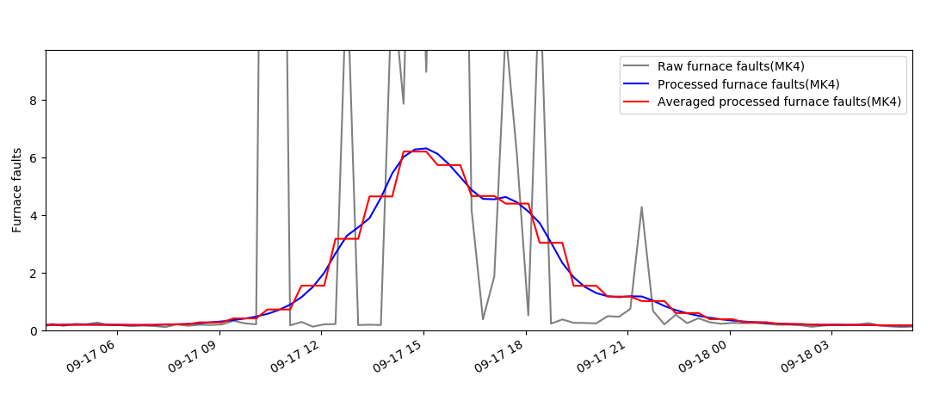
Dataset 2 (2020 to 2021, around N=11500)
Averaged after filtering MK4 data (sensitivity =1hr)

Slide 14
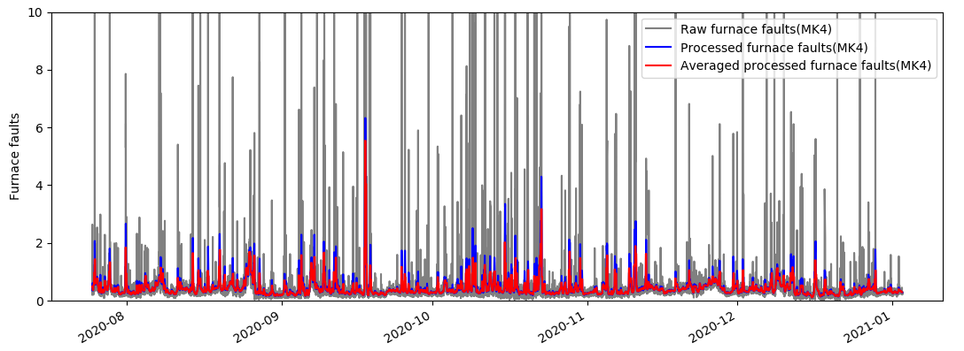
Dataset 2 (2020 to 2021, around N=11500)
Averaged after filtering MK4 data (sensitivity =3hr)

Slide 15
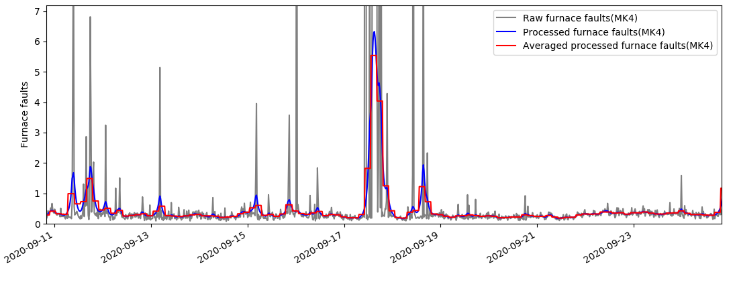
Dataset 2 (2020 to 2021, around N=11500)
Averaged after filtering MK4 data (sensitivity =3hr)

Slide 16
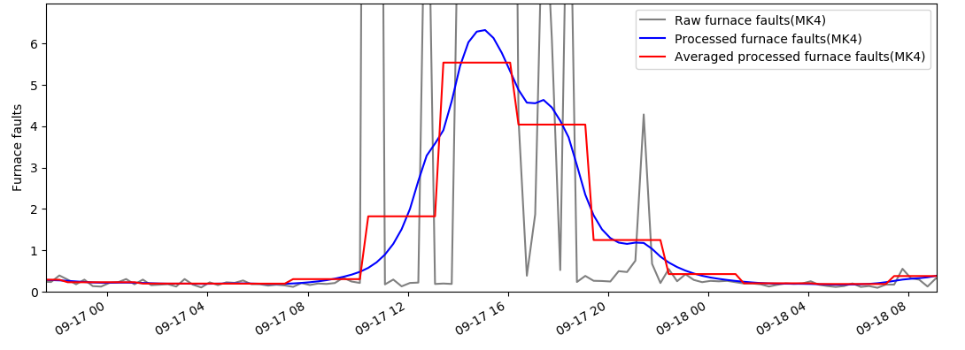
Dataset 2 (2020 to 2021, around N=11500)
Averaged after filtering MK4 data (sensitivity =3hr)

Slide 17
List of activities
MKIV data conditioning analysis
Sensitivity study on effect of changed on error/prediction accuracy?
Use the continuous N = 11623 data for training and testing.
Relevant inputs grouped by their potential controllability
Online linear regression

Slide 18
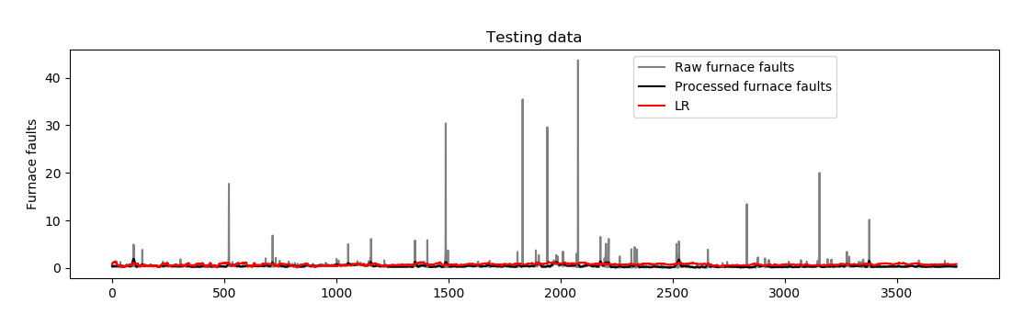
MSE scores comparison:
MSE score for furnace faults predicted using MK4 sensor data.
 | Before Averaging | 1hr | 3hr
Score | 0.1706 | 0.1674 | 0.1644

Slide 19
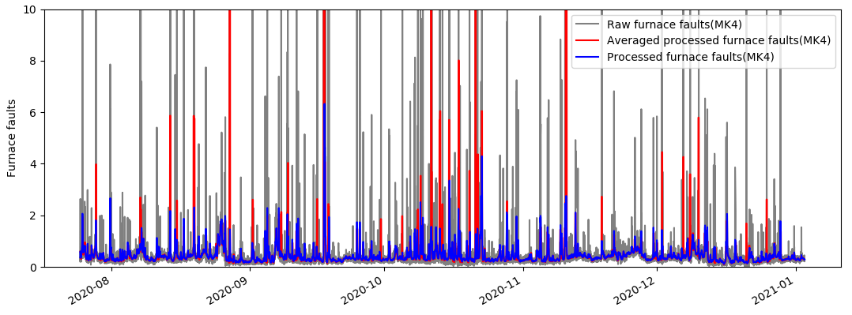
Dataset 2 (2020 to 2021, around N=11500)
Averaged before filtering MK4 data (sensitivity =3hr)

Slide 20
List of activities
MKIV data conditioning analysis
Sensitivity study on effect of changed on error/prediction accuracy?
Use the continuous N = 11623 data for training and testing.
Relevant inputs grouped by their potential controllability
Online linear regression

Slide 21
Relevant inputs grouped by their potential controllability
MV – Manipulated Variables. These are manually controlled variables directly available to suggestive tool.
MV (Indirect) – These are manipulated variables, but indirectly controlled by an existing PID controller. For example, port combustion air flows.
CV (Auto) – These are controlled variables as part of existing PID control loops. These may be available to the suggestive tool for setpoint adjustments. For example, canal temperature.
CV – Controlled Variables. These are the furnace variables that will be affected because of a change of MV, MV (Indirect), CV (Auto) and UV.
UV – Uncontrolled Variables. These are input variables we have little or no influence over. For example, wind speed.

Slide 22
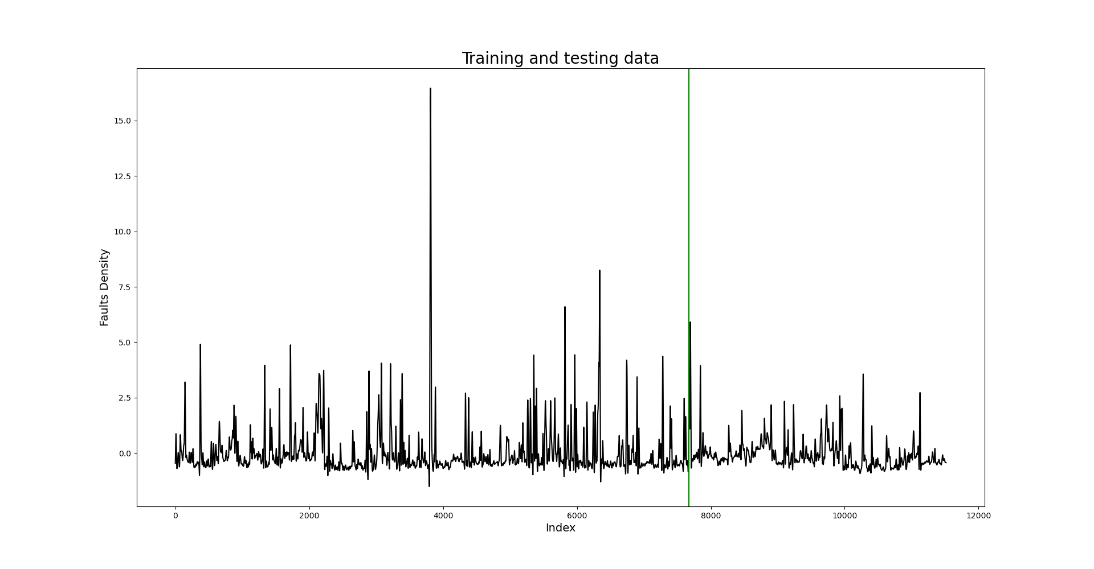
Dataset from 2020 to 2021, N=11623
We use 2/3 of N for testing and the last 1/3 for training
N = 7785
N = 3838
Training data
Testing data

Slide 23
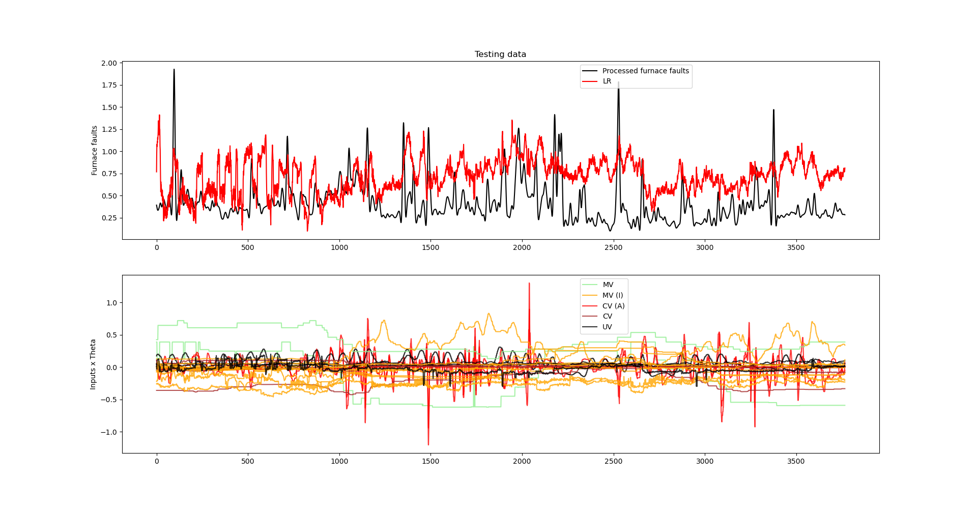
Relevant inputs grouped by their potential controllability

Slide 24
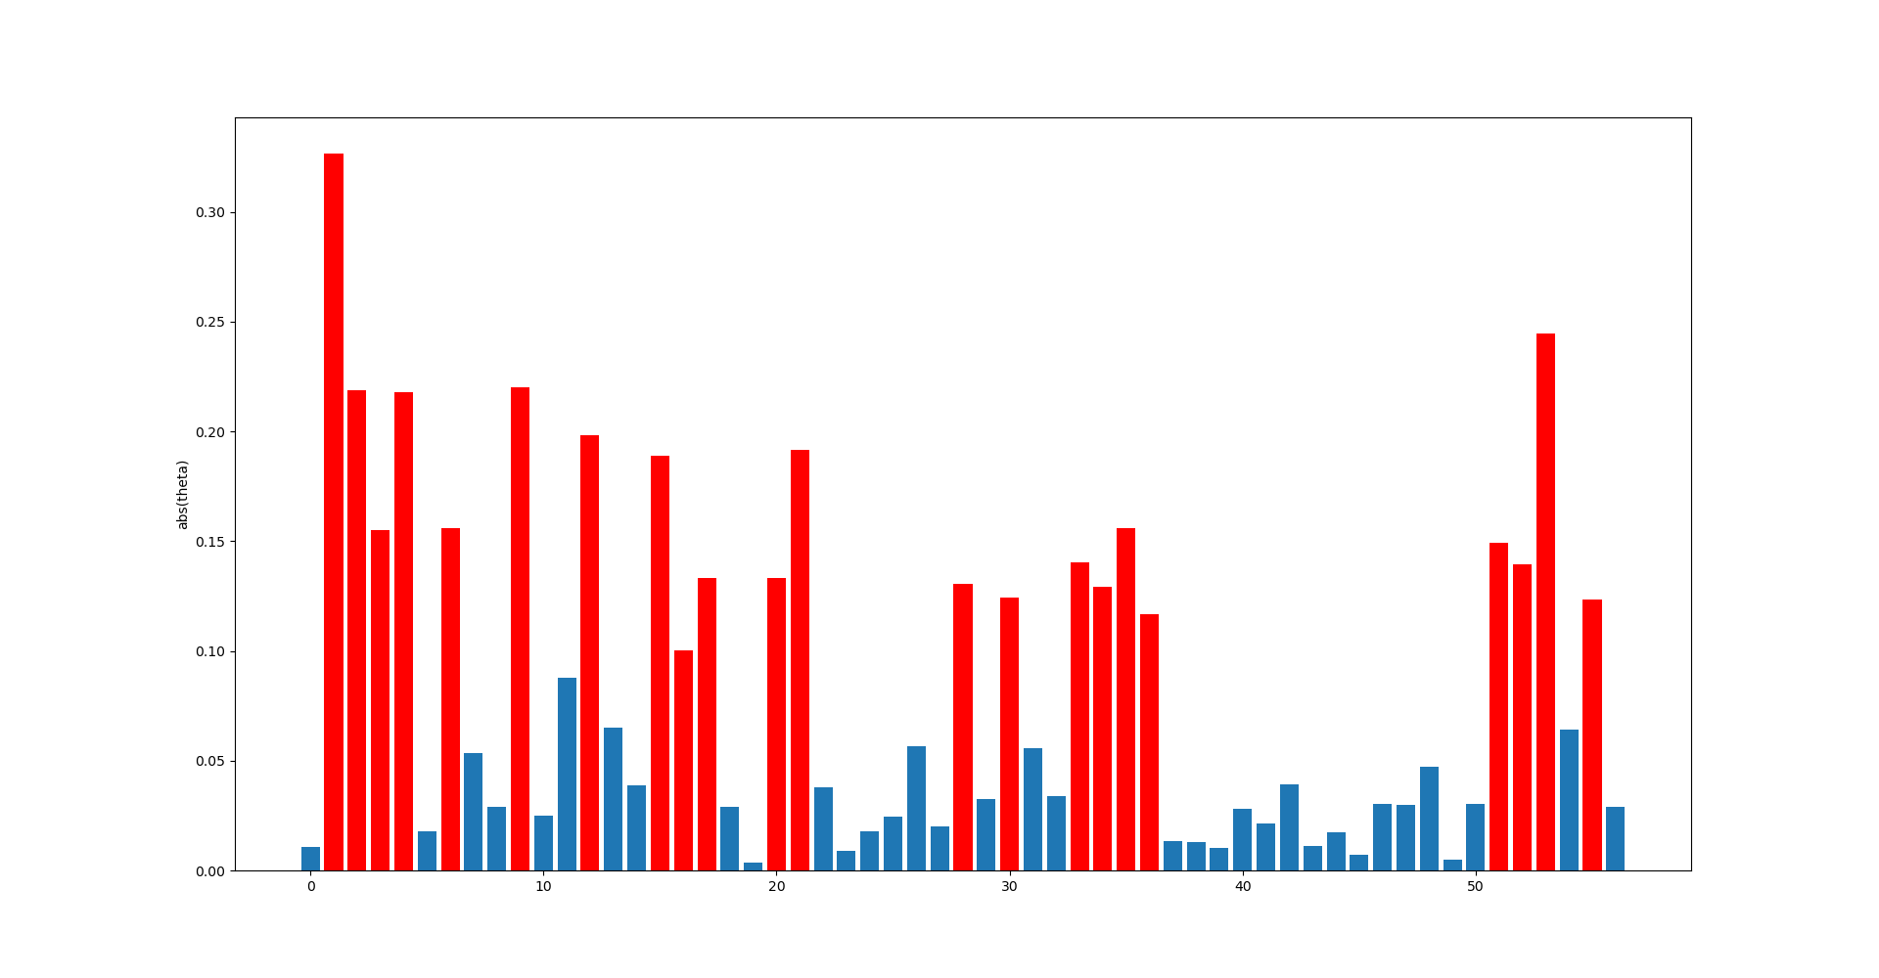
Relevant inputs grouped by their potential controllability
6539 Bath Pressure (PV)
10425 Calculated Cullet Ratio
1950 Canal Temp. Control Pyrometer (2)
10279 Canal Temp. Control (PV)
2922 Closed Bottom Temperature - Downstream Working End (PV)
2921 Closed Bottom Temperature - Upstream Working End (PV)
11213 Essential Services Board Cat 'B' Supply - MV53
11201 Furnace & Services Pack Sub S8 L.H. Section - HV13
11174 Furnace Bottom Temperature 18m D/S of B8
10091 Furnace Load
321 Glass Level Control (PV)
7474 Lehr Drive Line Shaft Speed
10271 Open Crown Temperature - Upstream Refiner (PV)
7443 Outside Ambient Temperature Measurement
11108 Port 1 Combustion Air Flow RHS (OP)
11111 Port 2 - 3 Combustion Air Flow LHS (OP)
11114 Port 2 - 3 Combustion Air Flow RHS (OP)
9400 Port 2 Gas Flow (SP)
136 Total Combustion Air Flow Measurement
135 Total Firm Gas Flow Measurement
9282 Tweel Position
11301 UK5 Total Load (Power)
MV MV (I) CV (A) CV
UV

Slide 25
List of activities
MKIV data conditioning analysis
Sensitivity study on effect of changed on error/prediction accuracy?
Use the continuous N = 11623 data for training and testing.
Relevant inputs grouped by their potential controllability
Online linear regression

Slide 26
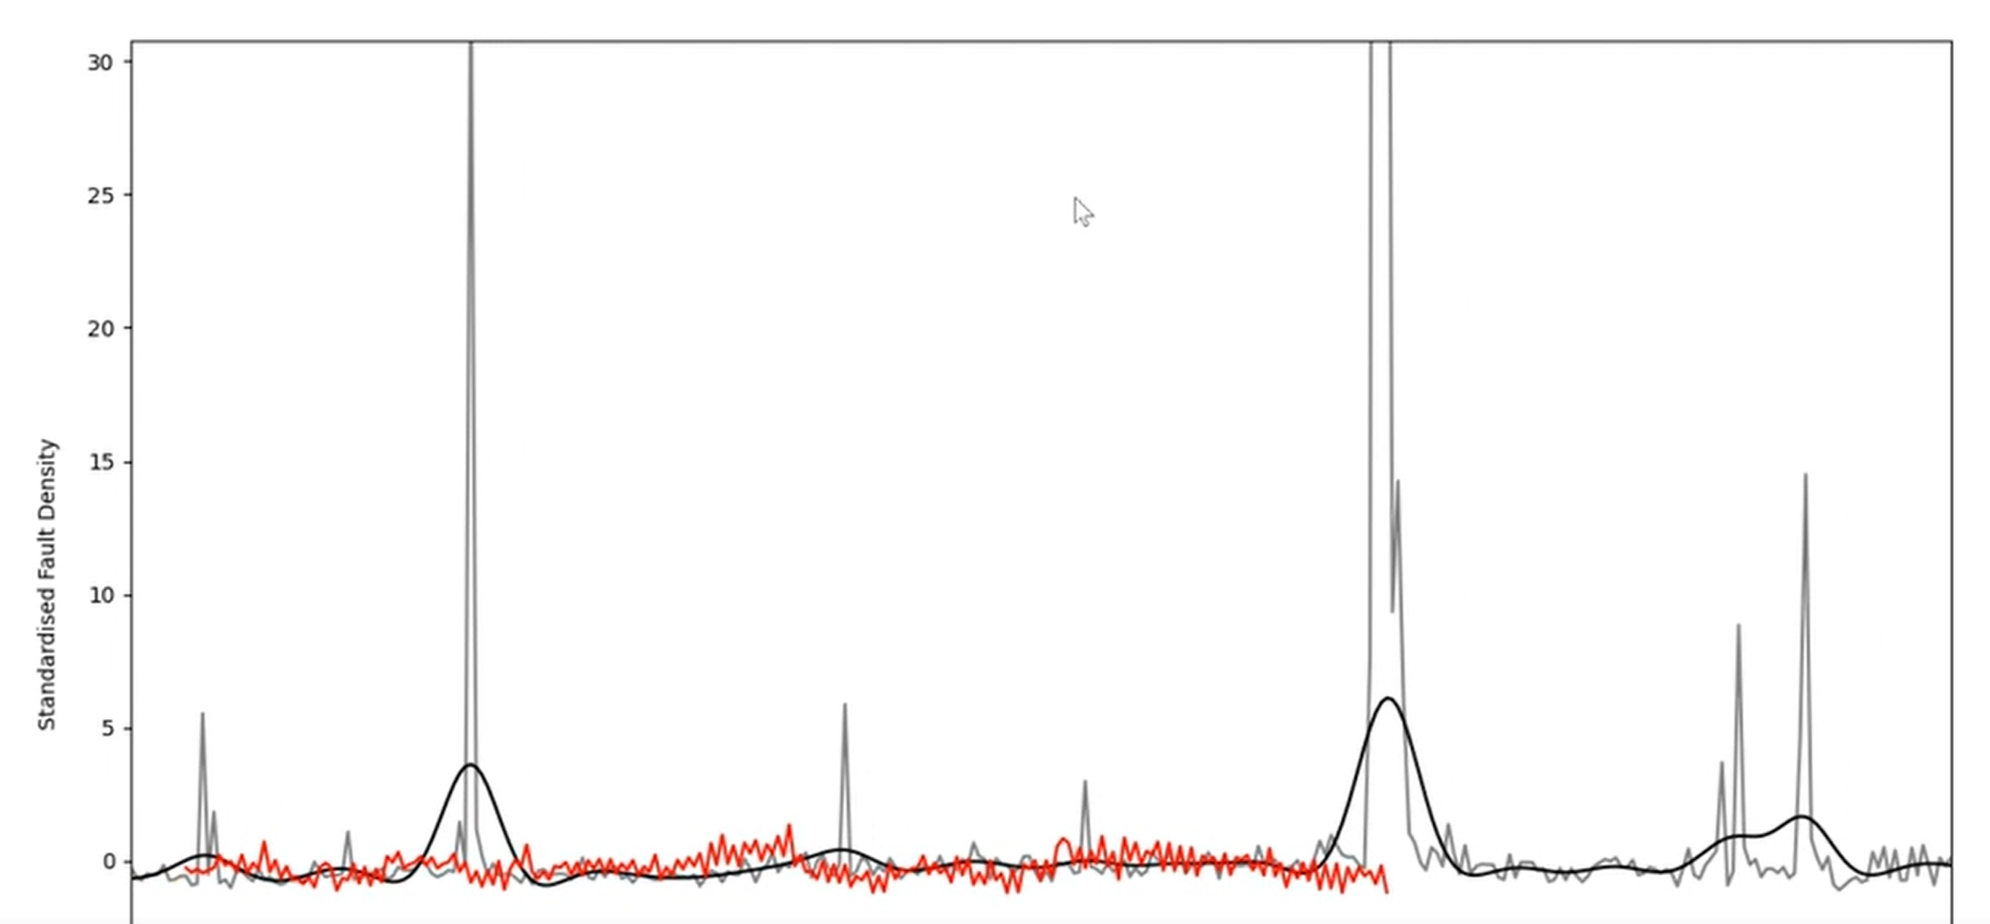
Online Linear Regression
Focusing on the development of a model where future inputs are assumed known, we can now deploy our online linear regression model.
The following results are in a video (currently too big for the SharePoint but might try a private upload to YouTube?)

Slide 27
Online Linear Regression
Focusing on the development of a model where future inputs are assumed known, we can now deploy our online linear regression model.
The following results are in a video (currently too big for the SharePoint but might try a private upload to YouTube?)
Now

Slide 28
Online Linear Regression
Focusing on the development of a model where future inputs are assumed known, we can now deploy our online linear regression model.
The following results are in a video (currently too big for the SharePoint but might try a private upload to YouTube?)
Fault density predicted 72 hours into the future

Slide 29
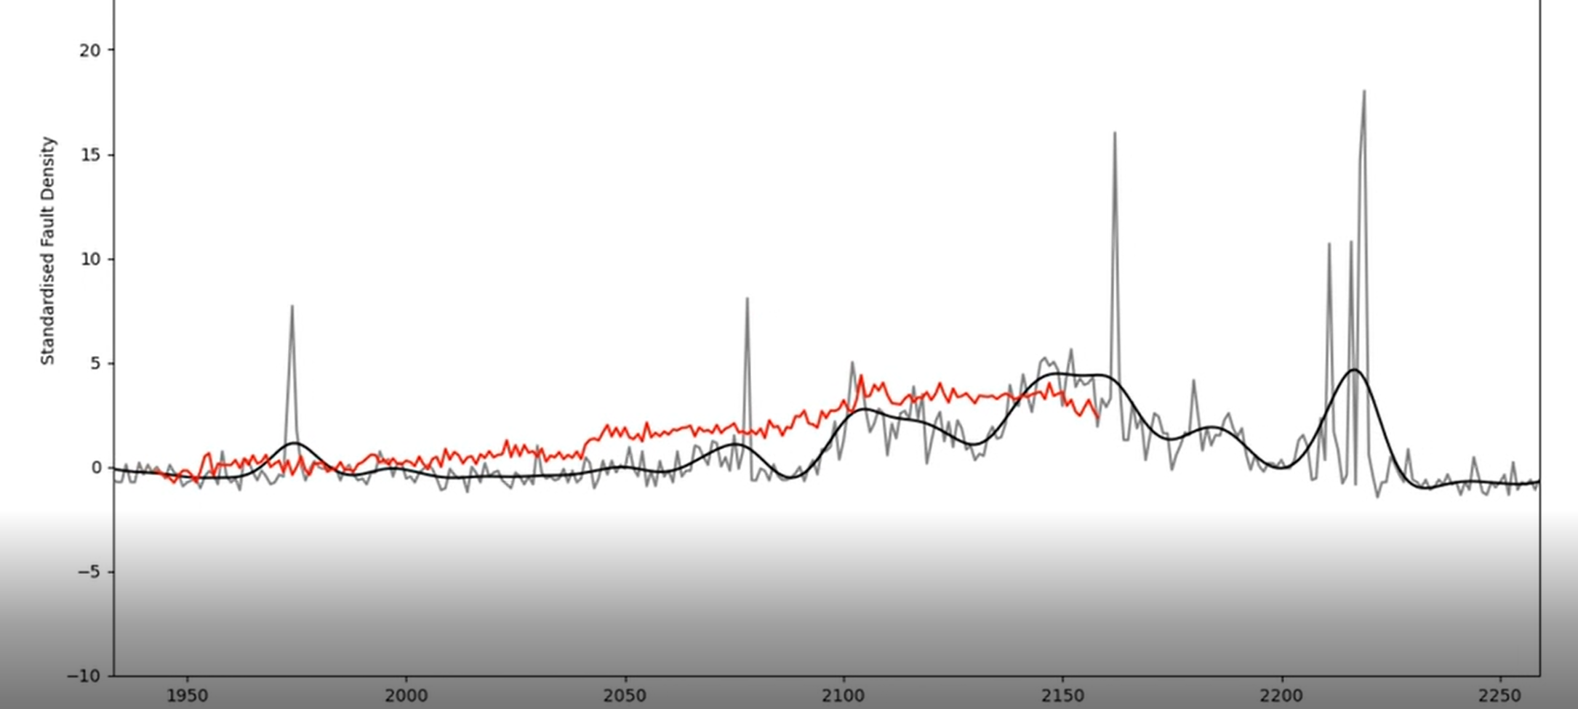
Online Linear Regression
2,000 – encouraging prediction of region of fault density

Slide 30
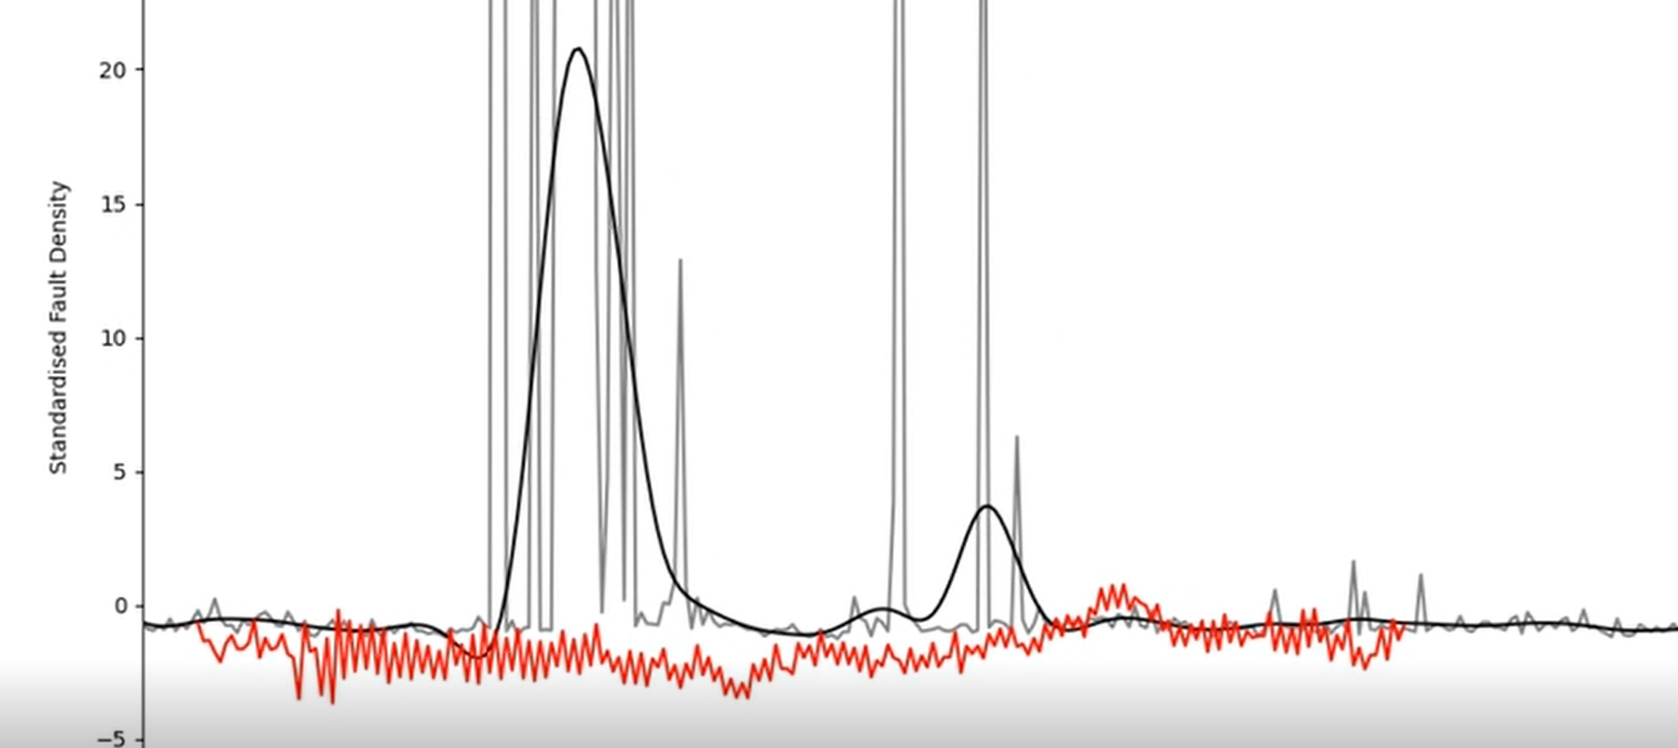
Online Linear Regression
3,800 – model predictions are affected by a large set of spikes in the fault density data

Slide 31
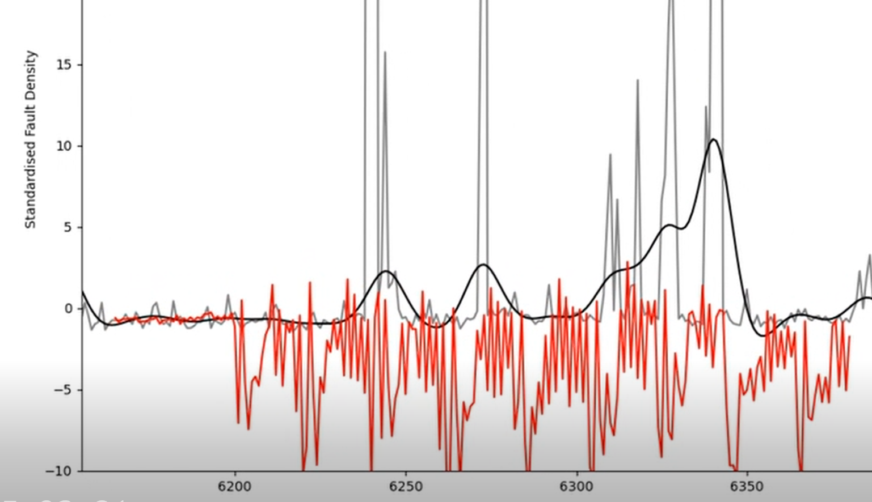
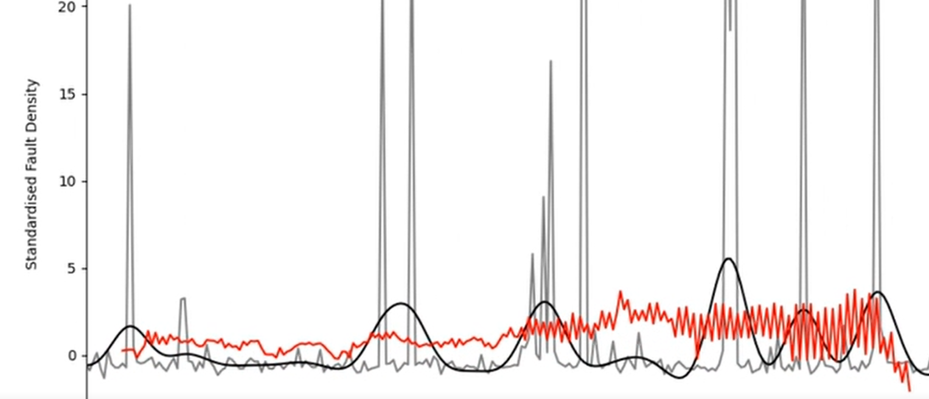
Online Linear Regression
5,300 and 6,200 a regions of poor fault density isn’t predicted but the model indicates that one of the important inputs have started to oscillate in an unusual way?

Slide 32
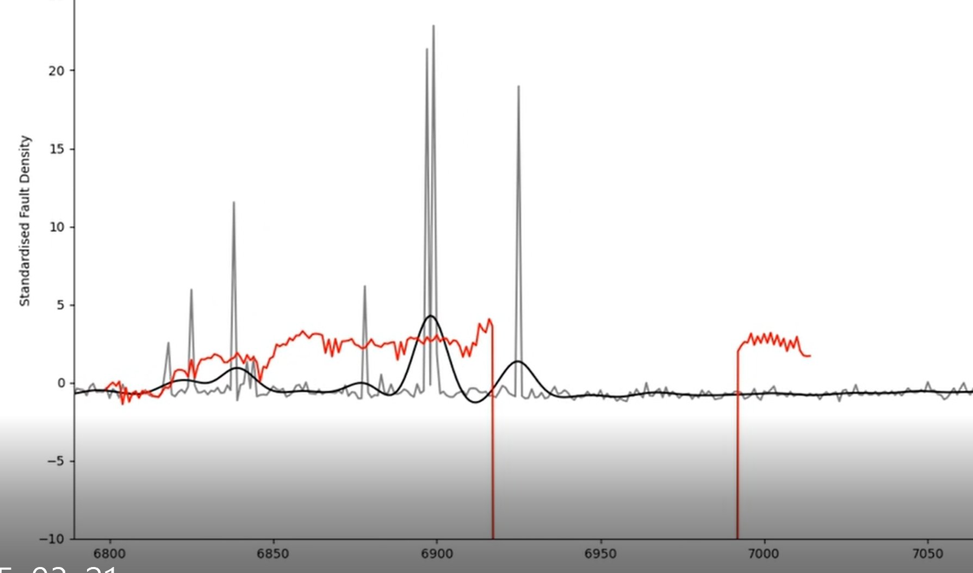
Online Linear Regression
6,900 a significant change in model input leads to unstable behaviour…

Slide 33
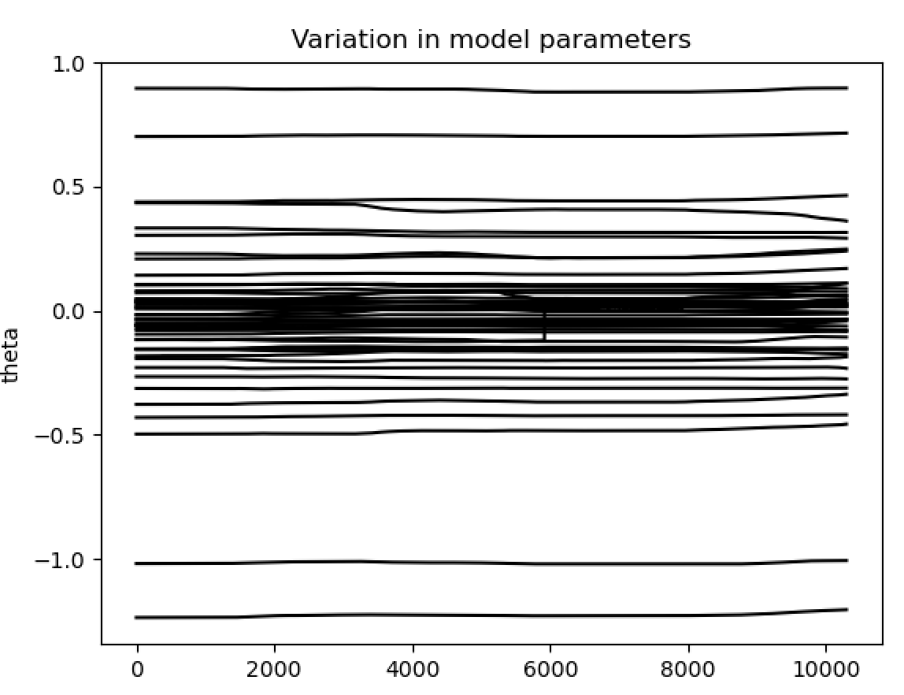
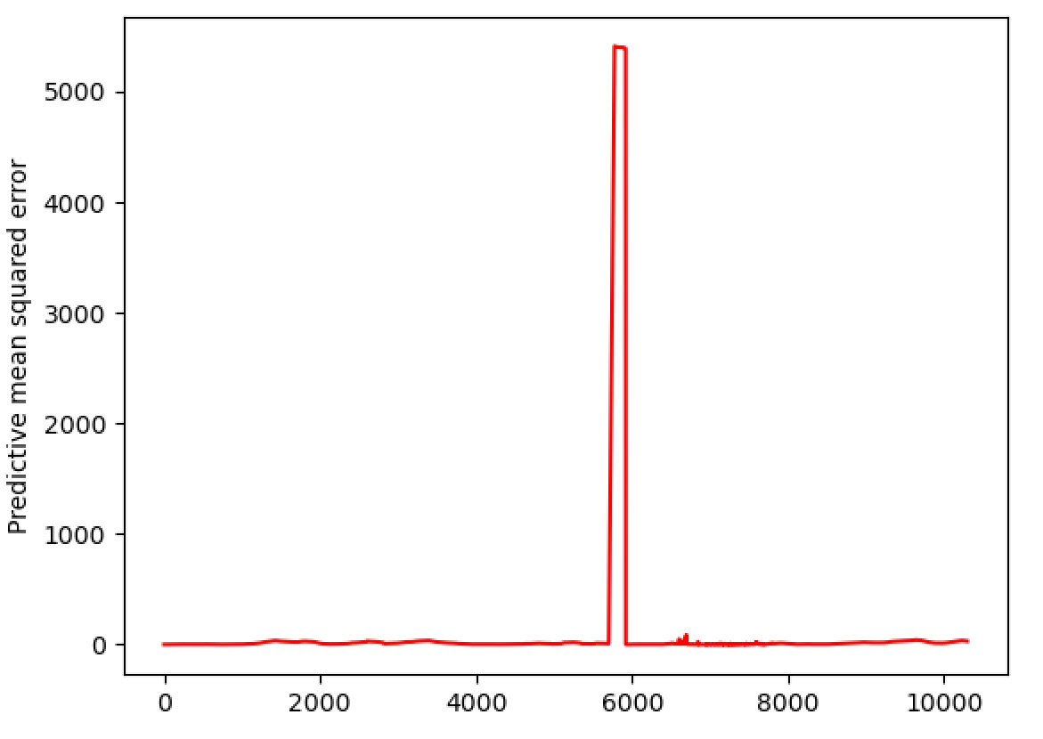
Online Linear Regression
Region where the ‘instability’ occurs.
Rate these change is controlled by a ‘learning rate’ parameter.

Slide 34
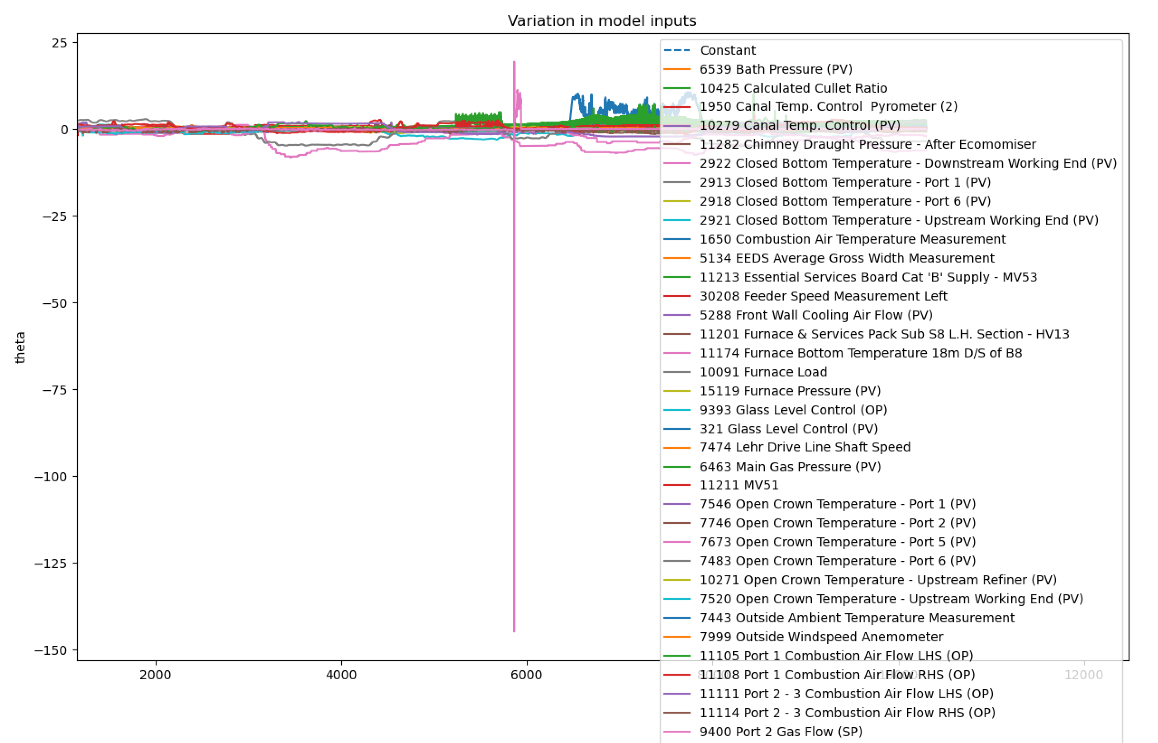
Online Linear Regression
Not a very helpful plot… Isolating the model inputs that realised absolute values larger than 10…

Slide 35
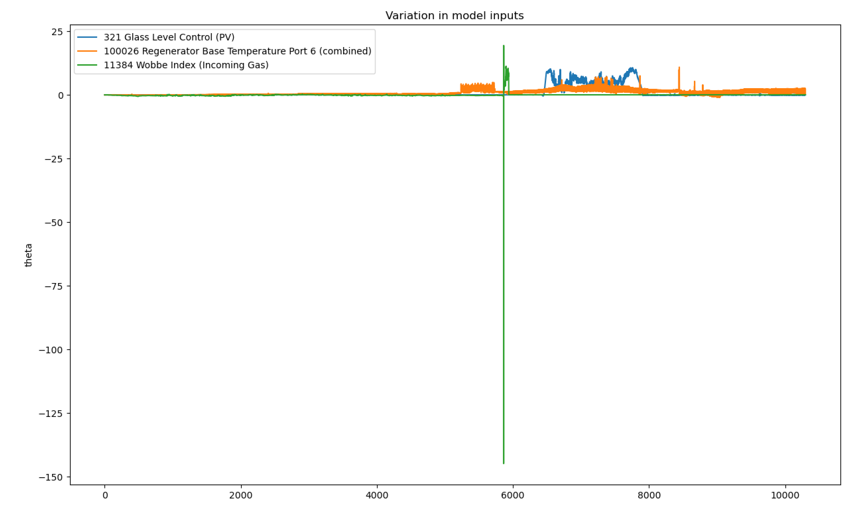
Online Linear Regression

Slide 36
Online Linear Regression

Slide 37
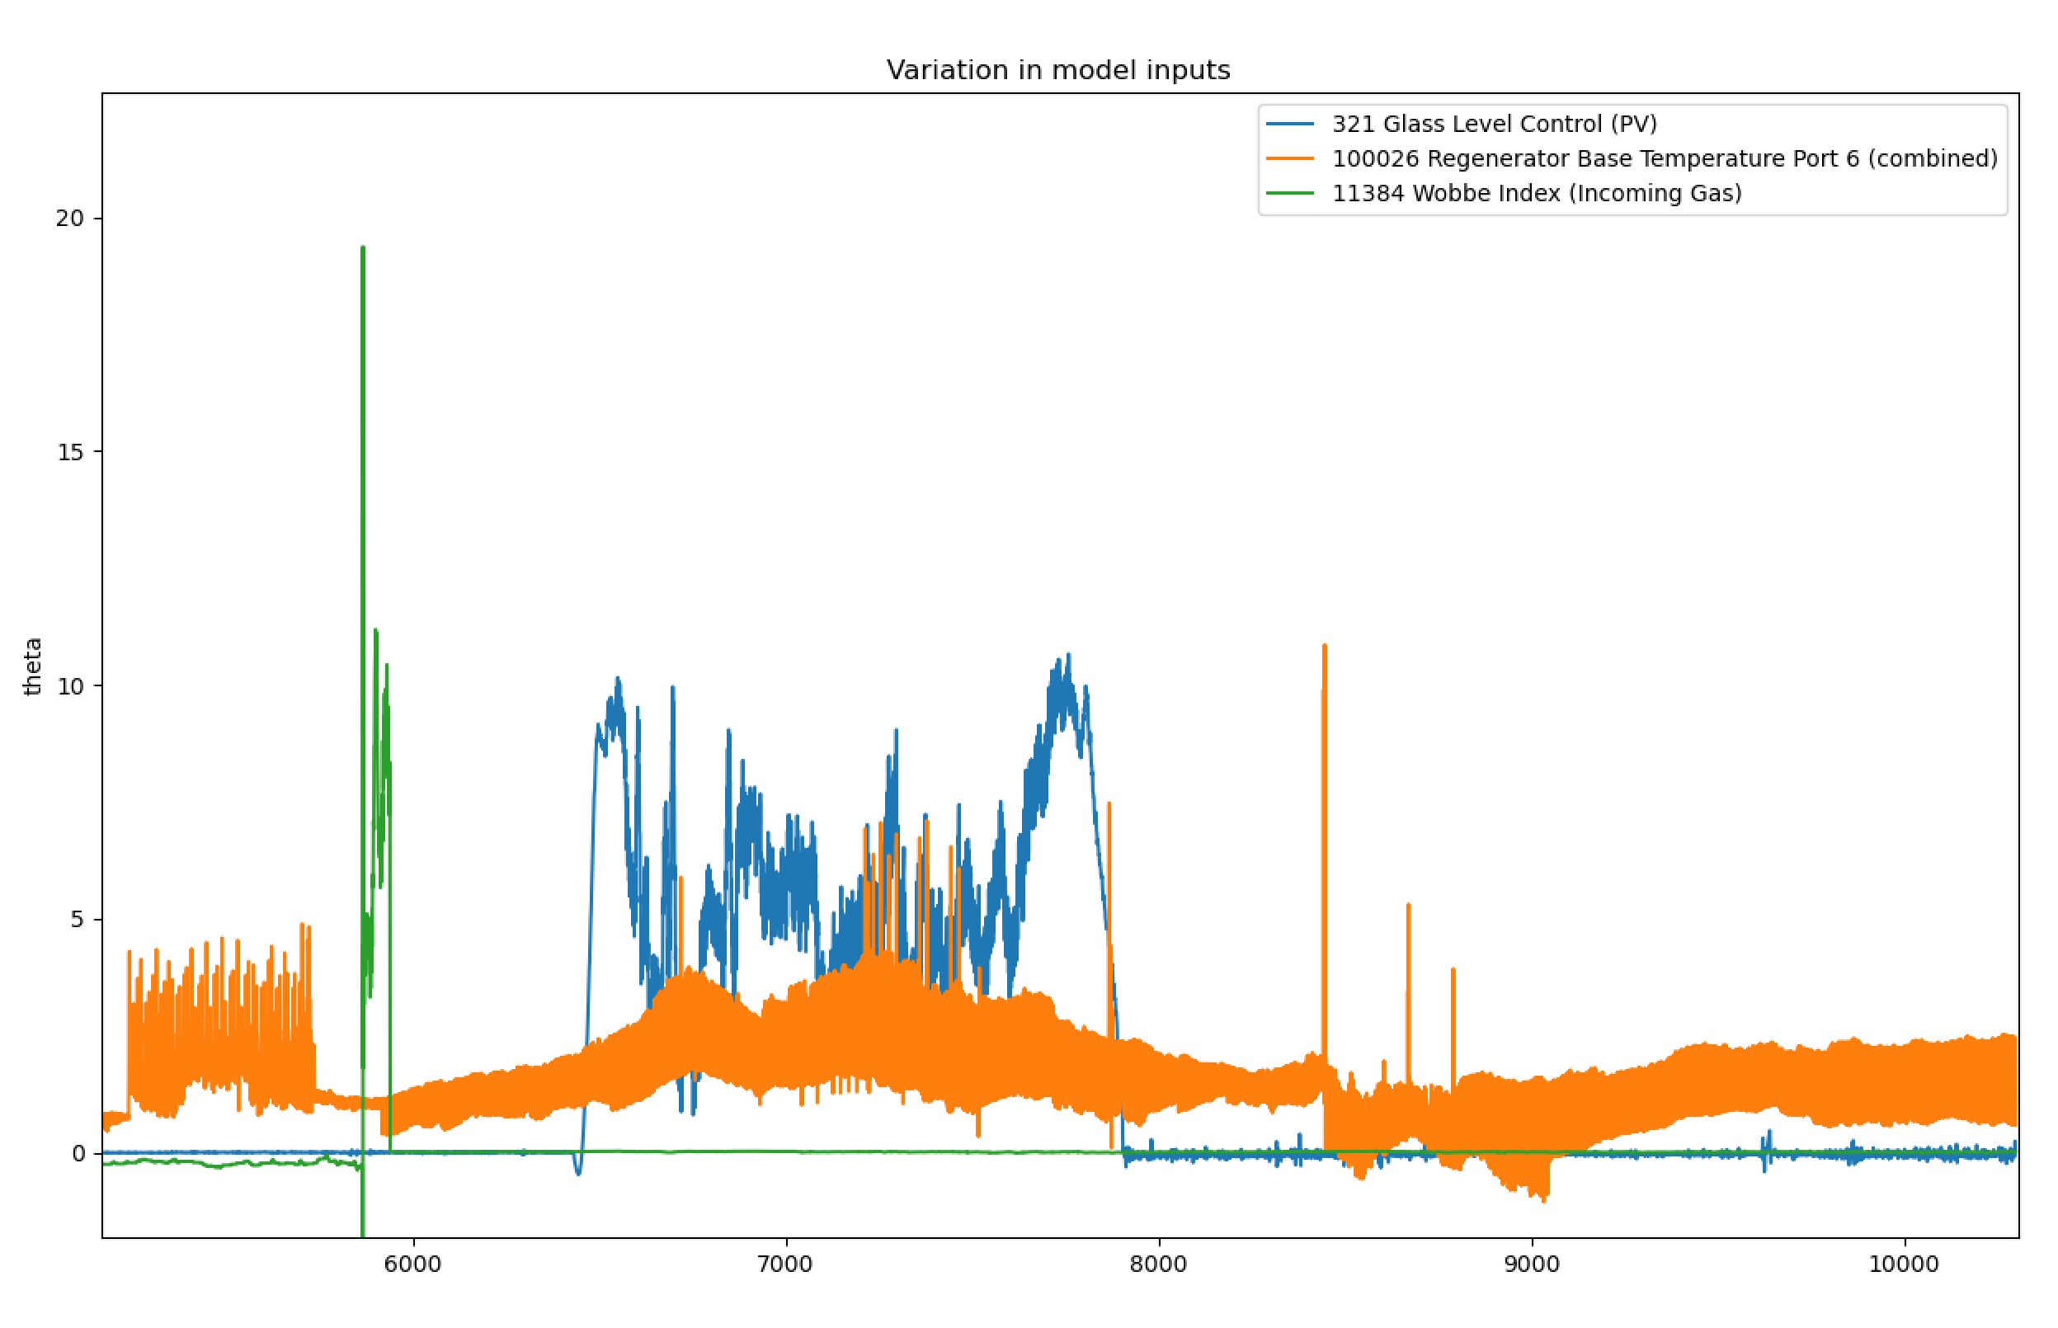
Online Linear Regression

Slide 38
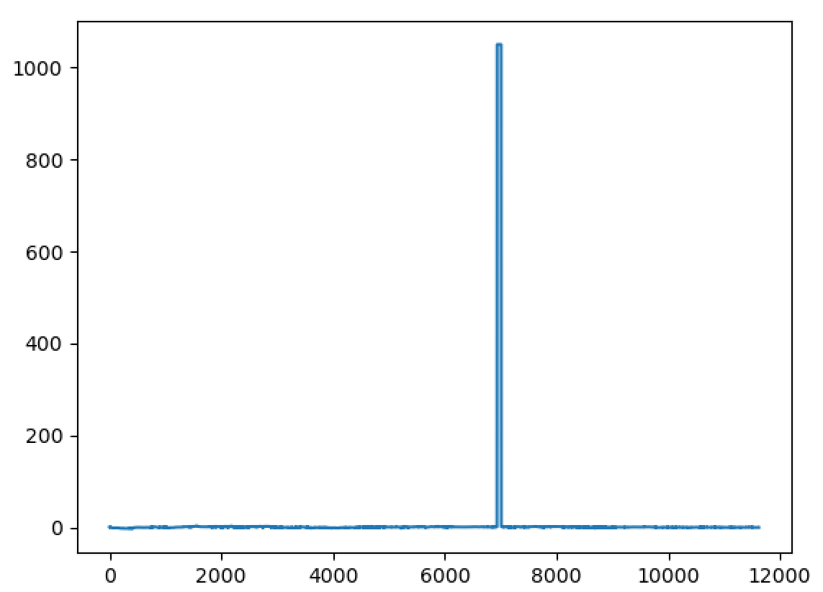
Online Linear Regression
Finally, a plot of how the Wobbe index (Incoming Gas) varied.

Slide 39
Next Steps
A closer analysis of how the inputs affected the results realised by the online regression model (including plotting their ‘controllability’).
Perhaps this is a first opportunity for use to learn from the model (identifying what may have caused a rise in fault density)?
Continued improvement of the online predictions (time lags etc.)
Longer term we need to start thinking about our strategies for…
Addressing spikes in the MK4 data
Mapping from our different types of input variable to predictions (a comprehensive list of what the online model thinks is ‘important’ should help this discussion).
Graphical User Interface to help us interpret results?

